Slide 1

Cornerstone Elementary
Gifted Services
September 11, 2025
Notes:
Customize this slide with your meeting information.

Slide 2
Cornerstone Elementary
Gifted Services
Seprtember 11, 2025

Slide 3

Meet our GT Teachers (Elementary)
1st Grade: Mrs. Gilmore, Mrs. Ibrahim, Mrs. Griffin
2nd Grade: Mrs. Derr, Mrs. Maybee, Mrs. Rogers
3rd Grade: Mrs. Chalmers, Ms. Marsh, Mrs.Pfeiffer, Mr. Neesley, Mrs. VanTine
4th grade: Ms. Acayan, Dr. Exum, Mr. Bordt, Dr. Little, Mrs. Hegde, Mrs. Fouhey
5th Grade: Mrs. Morton, Mrs.Leavitt, Mrs. Triska, Mrs. Sabio, Ms. Tourgoly, Mrs. Voelkel
Notes:
Elementary - Enter GT teachers' names (duplicate if necessary)
Secondary Only – Delete this slide

Slide 4
Fort Bend ISD Gifted and Talented
Areas Served
FBISD Gifted and Talented Student
English Language Arts
Mathematics
Social Studies
Science
Students are currently identified and served in the 4 core areas.
Notes:
Your child is identified in either Math and Science, ELA and SS, or all areas. Your child’s teacher in these subject areas will provide differentiation according to your child’s needs.

Slide 5
Differentiation is…
“… a teacher’s response to a gifted learner’s needs.” (Carol Ann Tomlinson)
“… customizing instruction so every gifted learner experiences continuous learning.” (Bertie Kingore)
Notes:
Read the quotes from GT experts.

Slide 6
How do we Differentiate?
2P’s | 2 C’s | 2 F’s
Pre-assessment | Choice | Feedback
Perky Pace | Challenge | Flexibility
Gentry, M. (2014). Total School Cluster Grouping and Differentiation: A Comprehensive Research Plan for Raising Student Achievement and Improving Teacher Practices (pp 100 – 105)
Notes:
Pre-assessment
Pre-assessment helps teachers reduce unnecessary practice. What students already know is highly correlated to what they will learn in the future (Marzano 2004). These pre-assessments can be formal (pre-tests) or informal (quick writes and surveys). Teachers also assess for any affective needs (self-efficacy, motivation, social skills).
Perky Pace
Perky Pace means teaching the required content at a rate that keeps the student’s attention and does not linger unnecessarily on basic content. There are times when a gifted learner will need extended time on a particular content area.
Choice
Choice refers to how the participates in learning or displaying mastery of the content. This builds leadership and creativity in students.
Challenge
Ensures that student engages in activities that are meaningful and appropriately difficult. Kanesvsky (2011) refers to this as deferential differentiation; allowing students to make choices while ensuring the academic standards are met in a complex and more in-depth way.
Feedback
The greatest impact a teacher can have on students success on independent self-selected tasks is providing prompt and customized feedback.
Flexibility
Teachers do not rely on assumptions of gifted learners. Respectful differentiation is sensitive to culture, gender, age, and ability level.

Slide 7
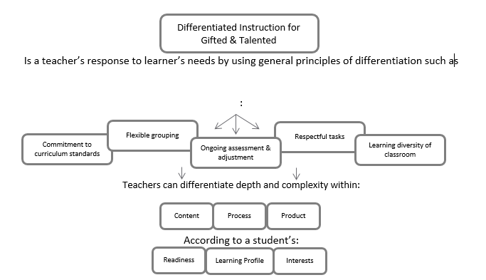
How do we Differentiate?
Notes:
Sophisticated Learning Products
Visit www.texaspsp.org Explain GT Project at your campus
Acceleration:
Presentation posted at www.fortbendisd.com/gifted

Slide 8

GT Services for Elementary Students includes ...
Elementary (K-5)
Cluster Grouping with differentiated instruction in core content areas (ELA, SS, Math, Science)
Notes:
Currently students in elementary are cluster grouped with a GT trained teacher where instruction is differentiated to meet their needs.

Slide 9
Cluster Grouping
Gifted and Talented students are ensured opportunities to work together as a group, work with other students, and work independently during the school day as well as the entire school year.
GT students are placed together for instruction in the appropriate content area(s) for which they have been identified in cluster grouping.
Teachers are trained to adapt curriculum and instruction for their gifted learners.
Notes:
Differentiating the pace of learning for GT students provides an opportunity for them to learn at a pace commensurate with their abilities in order to maintain their interest and provide a developmentally appropriate level of challenge. Acceleration practices involving pacing include continuous progress, curricular compacting, and subject-matter acceleration.

Slide 10
GT Initiatives
Notes:
TPSP applies to all campuses. Delete slides 13 – 18 for GT Learning Plan and Innovation Hour if these initiatives are not on your campus.

Slide 11

Innovation Hour
Notes:
Only share if you are an Innovation Hour campus.

Slide 12
Innovation Hour
Innovation Hour provides GT students with an opportunity to hone their social and communication skills while exploring a topic that they are curious and/or passionate about while in the school setting.
Innovation Hour is an in-school enrichment learning experience for students in __ grade.
Notes:
Add the grade levels for your campus in the blank. Example 2nd-3rd , 3rd-4th, etc.

Slide 13

GT Learning Plan
Notes:
Only share if you are a GT Learning Plan campus.

Slide 14
GT Learning Plan
The GT Learning Plan (GTLP) is a written record of gifted and talented programming utilized with each gifted child. and provides opportunities for students to develop academic and affective (social and emotional) goals.
The GTLP provides opportunities for students to develop academic and affective (social and emotional) goals that are monitored by the teacher and student.
Notes:
COGS may add an additional slide with upcoming dates/timeline

Slide 15
Gifted and Talented Learning Plan: SMART Goals
SMART goals describe the specific and measurable programming emphasis for annual learning and growth
The areas selected as priorities for SMART goals are monitored through ongoing assessment.
SMART Goals are linked to specific instructional strategies.
Planning guide for making instructional decisions about materials, programming options and assessments for gifted students based upon strengths, interests, and social-emotional needs.
Notes:
The GT Learning Plan will be completed in Skyward by the teacher and available to parents through Family Access in Skyward.

Slide 16
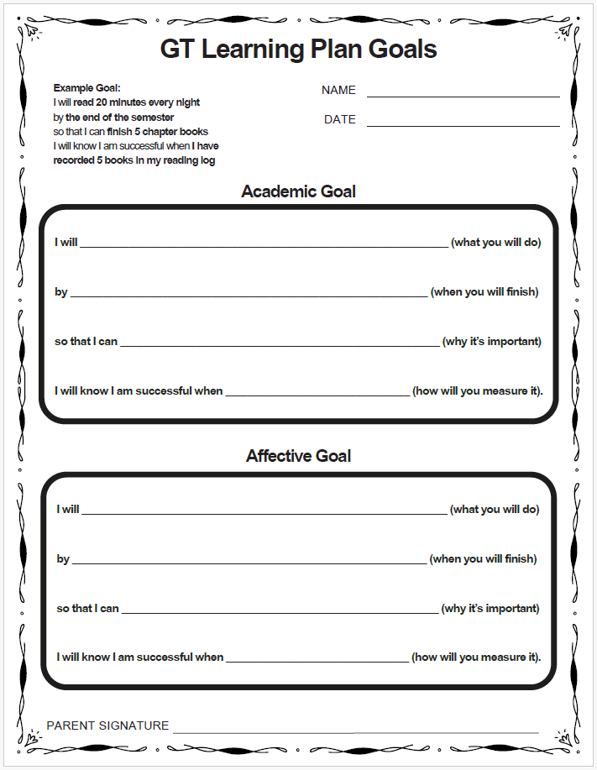
GTLP Template 2025-2026
Notes:
To help guide higher quality goals, the GT Department has developed this GTLP Goals Template. Teachers will use this to help students write high quality SMART goals.

Slide 17
Goal Setting Timeline
August 26-September 19
  GTLP Goal Development and Initial Conference window
September 22-30
  Elementary GTLP Goals Draft Due
September 22-30
  Secondary GTLP Goals Draft Due
    GTLP goals may be the same or an extension of campus goals
October 1-3:
  Parent Goal review/input: A GTLP collaboration/discussion opportunity
October 6-9 Elementary and Secondary (grades 1-12) GTLP finalized with Parent Signature Due
  Parents digital signature submitted through the Family Access Parent Portal in Skyward
October 9
  GT Learning Plan Signing Day (tentative)
Notes:
Share how parents are going to be made aware of/provide input on student’s goals (parent-teacher conferences, phone, email, or hard document. Let parents know that these timelines may change based on Skyward Q technical issues.

Slide 18
Additional Information

Slide 19

Acceleration Options in Fort Bend ISD
Curriculum Compacting
Partial Acceleration, by Content
Self-Paced Instruction
Credit by Exam
Advanced Placement
Dual Credit
Collegiate Enrichment Courses
Visit www.fortbendisd.com/gifted
for the full presentation on Acceleration Options in FBISD
Notes:
Visit www.fortbendisd.com/gifted for the full presentation on Acceleration Options in FBISD
Curriculum Compacting
A classroom strategy that makes adjustments to the curriculum
Adjustments include fewer introductory and/or on-level activities
Replaces on-level activities with rigorous content
May not result in advanced grade placement
Partial Acceleration, by Content
A school based practice that offers students higher level content
Physically moves to a higher level classroom for part of the day; or
Provides higher-level curricular materials within their own classroom.
Opportunities through talent searches and summer programs for gifted
Self-Paced Instruction
Gives students control over pacing and content decisions
Uses online platforms such as
Think Through Math,
Khan Academy
iStation
Reputable online courses (fees may apply)
Enhanced though campus implementation of TPSP/Project Based Learning

Slide 20
GT Parent Advisory Committee (PAC)
Who is the PAC?
The Gifted and Talented Parent Advisory Committee is comprised of parents in Fort Bend ISD who support the GT program offered by Fort Bend ISD. The PAC is a committed group of parents who provide feedback related to Gifted and Talented programming.
How do I volunteer?
Complete the PAC Interest Form today. Each campus is allowed up to three parents to serve on the PAC.
2025-2026 GT PAC Interest Form
Notes:
Take a moment to inform parents about the Parent Advisory Committee (PAC). If your campus do not have a PAC representative ask parents to consider to joining the PAC and completing the PAC Interest Form. I will upload the list of current PAC representatives in Schoology for your reference.

Slide 21
GT PAC Overview
Parent Liaison serves between the GT PAC & school community
Provide feedback to the GT PAC committee
Attends four scheduled meetings (in-person)
Host events designed for GT families
Notes:
Note that meetings are held in-person at the FBISD Administration Annex

Slide 22
Parent Resources
SENG –Supporting Emotional Needs of Gifted
  www.sengifted.org
NAGC –National Association of Gifted Children
  www.nagc.org
TAGT –Texas Association for the Gifted and Talented
  www.txgifted.org
PACE –Parents for Academic Excellence
  www.pacefortbend.org
Notes:
Here is a list of resources for parents of gifted students.

Slide 23




Parent Resources
https://www.davidsongifted.org/
http://cty.jhu.edu/
www.giftedandtalented.com
https://www.destinationimagination.org/

Slide 24
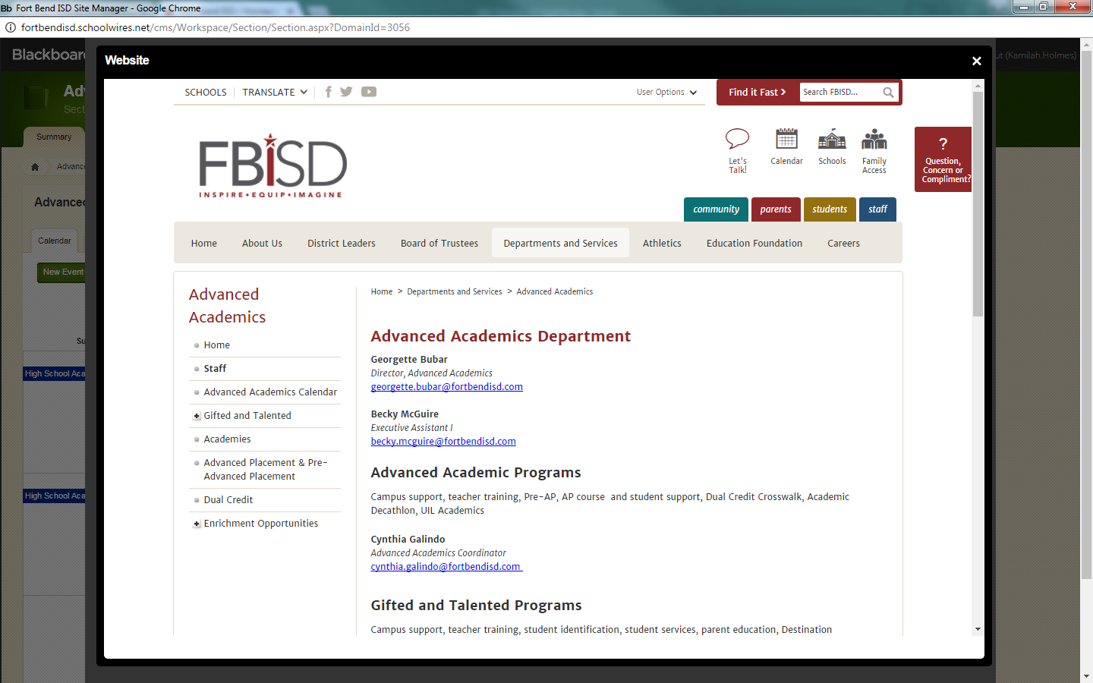
Contact Us!
281-634- 6400
GT Counselor
Melissa. Masters@fortbendisd.gov
GT Administrator
Jennifer.Bartels@fortbendisd.gov
GT Champion of Gifted Services
Monica.Wilson@fortbendisd.gov
GT Parent Liaison
Liaison.liaison@fortbendisd.com
Notes:
Customize this information with your campus contacts.

Slide 25


